Slide 1
SPAM CLASSIFICATION
USING
NATURAL LANGUAGE PROCESSING

Slide 2
PREPARED BY:
KM ZUBAIR (1722931)
TASNIM RAFIA (1725826)
BILLAH SYED MASHKUR (1723387)

Slide 3
Abstract
Communication plays a critical role in today's new age of digitalization, whether it be formal or informal communication. It has become more common to use email or other messaging platforms. This growth in electronic contact resulted in an exponential rise in the amount of emails or messages that are spammed.

Slide 4
Introduction
Every day, we get advertising spam messages. The are getting spread to promote less well-known items on the market. In this project, we will try to create a model that acts as a spam classifier and will actually classify the spam messages that we usually get in our email or other platforms that are used to send text messages.

Slide 5
Technical Background
Data Cleaning and Preprocessing -Regular Expression, Stopwords corpus, Porter Stemmer
Bag of Words
Naive Bayes Classifier
Confusion Matrix
Accuracy Score

Slide 6
METHODOLOGY

Slide 7
Principles of the code
Loading Dataset
Importing libraries
Preparing Dataset into the root words
Joining the root words into corpus.append(review)
Finding similar words into X using CountVectorizer
Declaring the column to be predicted
Splitting Dataset
Choosing algorithm, fitting dataset into model,
Evaluation

Slide 8
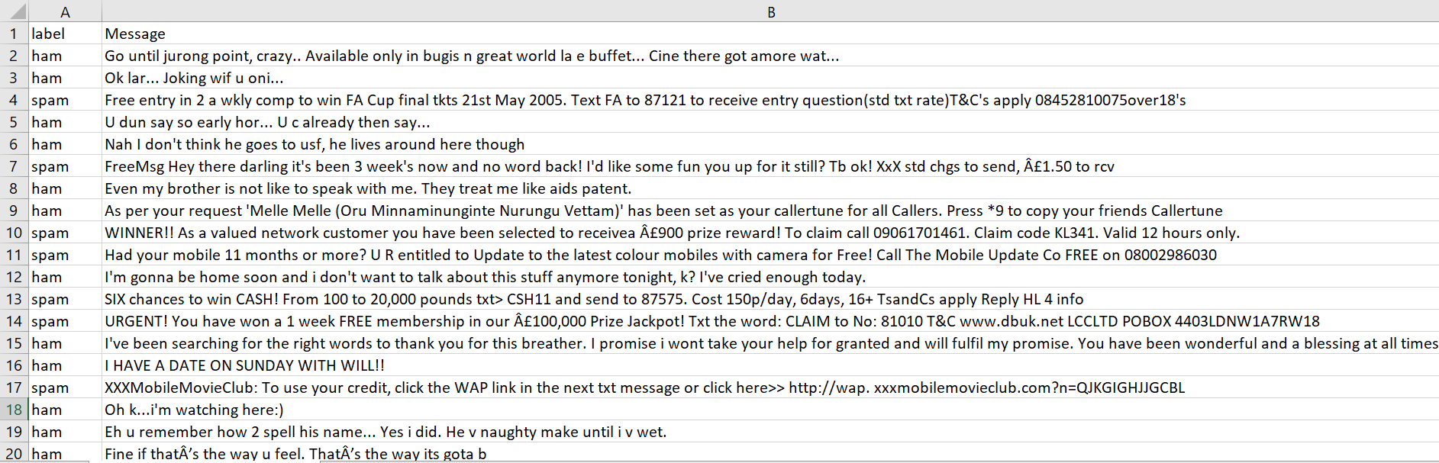
Dataset

Slide 9
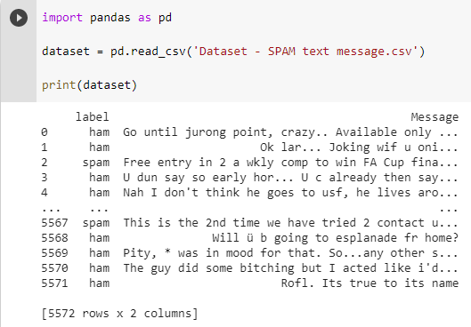
Loading Dataset

Slide 10
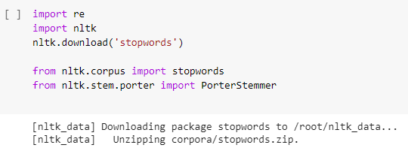
Why I imported
‘re, nltk, stopwords, PorterStemmer’ ?

Slide 11
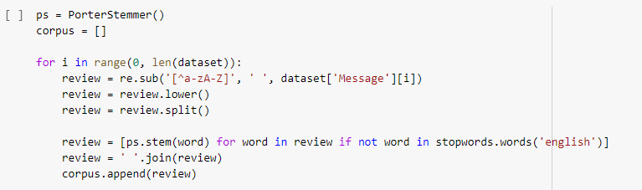
How the ‘PorterStemmer, loop and stopwords’ performed their function?

Slide 12
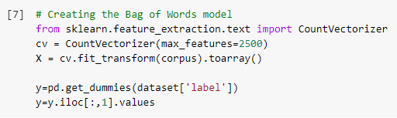
How does CountVectorizer help ?

Slide 13
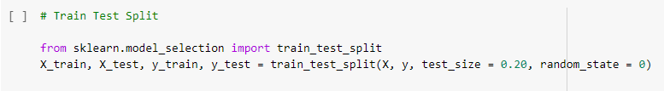
Dataset Splitting

Slide 14
What is Multinomial Naive Bayes algorithm ?
One of the most efficient learning algorithms, suitable for classification with discrete features like counting words for text classification, spam filtering etc.

Slide 15
‘Bag of Words’ Model
Pattern classification should respect 3 individuals:
-> Salient
-> Invariant
-> Discriminatory

Slide 16
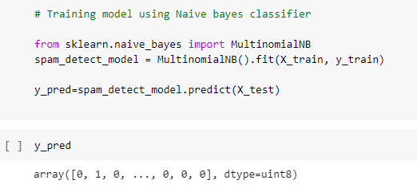
Training Splitted Dataset

Slide 17
RESULTS

Slide 18
WE COULD COME UP WITH THESE:
Confusion Matrix
Accuracy
Precisión
Recall
F1-Score
Other Comparison

Slide 19
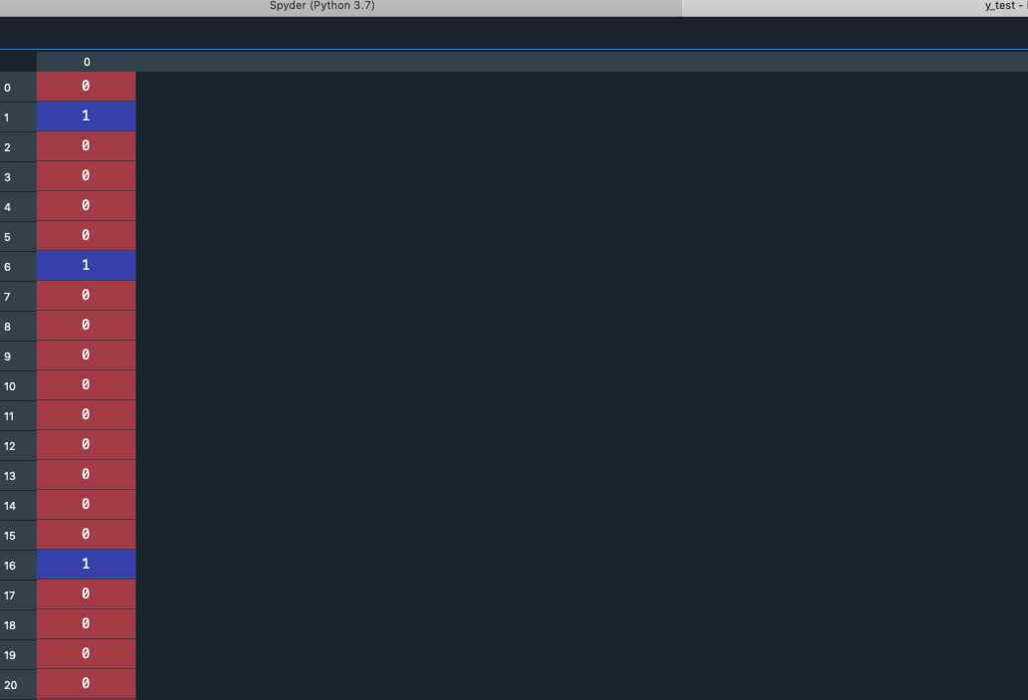
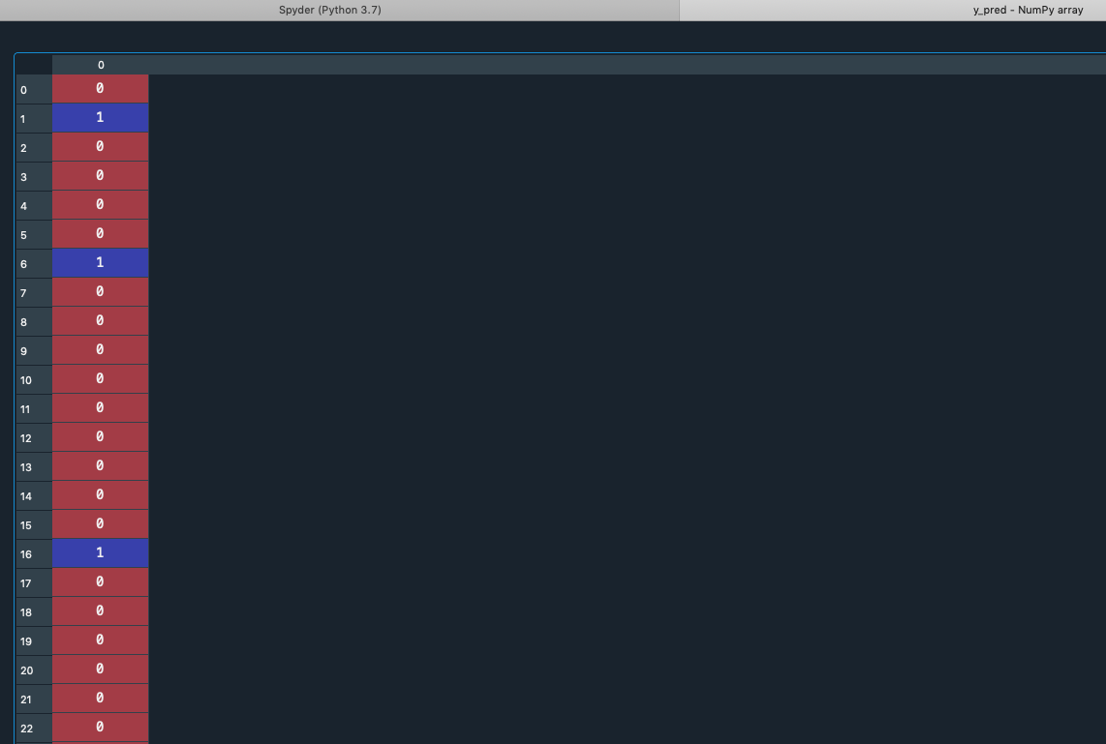
COMPARISON
Actual Results
Predicted Results
VS
1 = “Spam” 0 = “Ham”

Slide 20
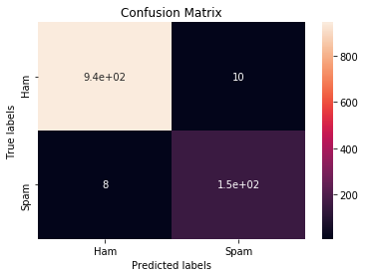
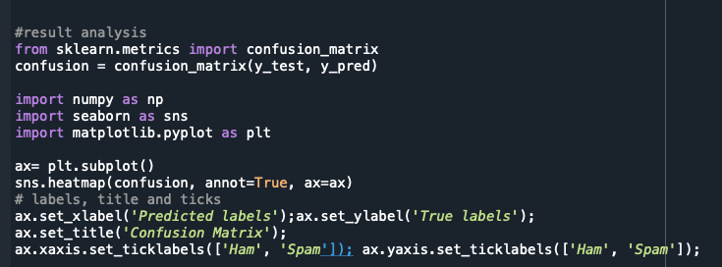
Confusion Matrix
Ham (TP) = 945
Spam(TN) = 152
FP = 10
FN = 8
Total = 1115

Slide 21
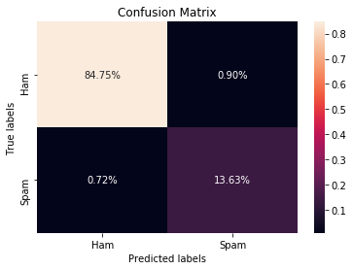
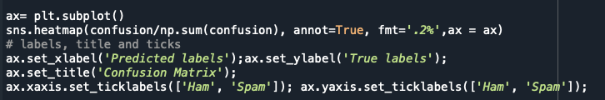
Confusion Matrix
Total Prediction with correction should be = TP + TN = (84.75% + 13.63%) = 98.38%

Slide 22

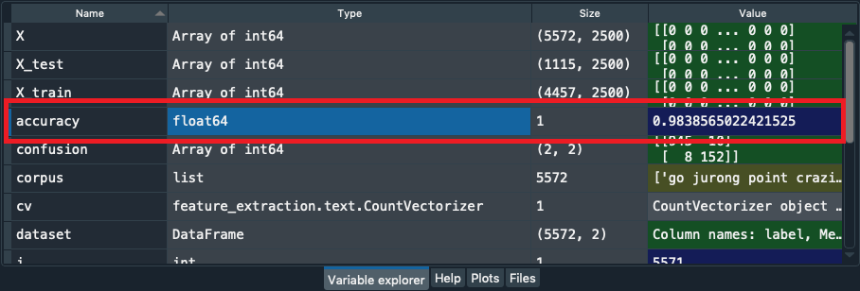
Let’s Check the Accuracy
Total Prediction with correction = 98.38% (same value)

Slide 23
Precision, Recall & F1-Score
F1-SCORE
RECALL
PRECISION
F1 Score might be a better measure to use if we need to seek a balance between Precision and Recall AND there is an uneven class distribution (large number of Actual Negatives).
Recall actually calculates how many of the Actual Positives our model capture through labeling it as Positive (True Positive)
Precision talks about how precise/accurate your our is out of those predicted positive, how many of them are actual positive.

Slide 24
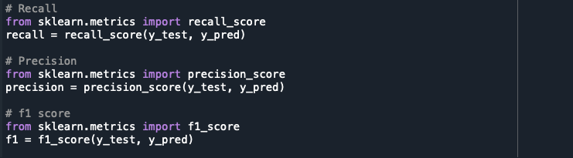
Precision, Recall & F1-Score
Precision | Recall | F1-Score
0.94 | 0.95 | 0.94

Slide 25
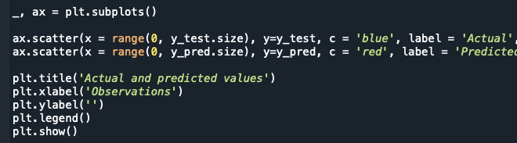
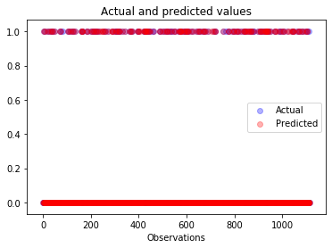
Scatter Plot
After comparing the actual and predicted data we can say that the predicted values are so close to the actual values

Slide 26
Error Analysis

Slide 27
Error Analysis
As our False positive (0.9%) and our False negative (0.72%) carry some values which is incorrect, so that the model cannot be claimed as the best model for spam detection but nonetheless it is considerable with an error rate of (0.9% + 0.72%) = 1.62% of incorrect prediction only.

Slide 28
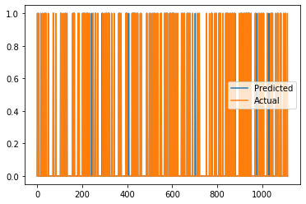
Error Analysis
By plotting the a 2D graph we can conclude that the predicted values are almost the same as the real values with a little unsimilarity which is even hardly noticed.

Slide 29

Error Analysis
For future works, maybe we can take a bigger dataset with more balanced features.
We could also take more than 2500 words as max_features(most frequently occurred words) inside the CountVectorization() function.
Word lemmatization could be also used in the future for better stemming purpose.

Slide 30
Conclusión
We proposed an integrated approach in this paper to identify a text message as spam or valid.
In the future, we plan to make our model’s application work in real-time. We also intend to expand the dataset that is used for both teaching and research.

Slide 31
THANK YOU

